Slide 1
The PIC microcontroller
PIC18F4520: Serial Buses (UART, I²C, SPI)

Slide 2
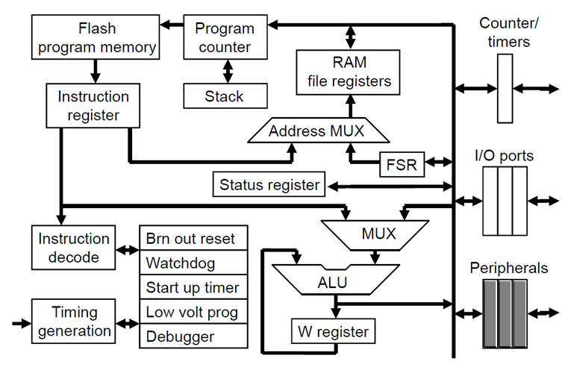
PIC18F: Controller Architecture

Slide 3
PIC18F: Notational convention
WREG
W Register
FREG
File Register (any register location from GPR Bank 0 / SFR)
[X]
Contents of register X
[WREG] = 0x02 ↔ WREG’s contents become 0x02
[0x20] = 0x34 ↔ RAM File Register 0x20 content becomes 0x34
[X] = [Y] ↔ Contents of Y are copied into X
Number systems
Decimal | d’10’
Hexadecimal | h’4A’ or 0x4A
Binary | b’1000 0010’

Slide 4
Interfaces parallel, serial

Slide 5
Electronics: Parallel Interface
What
Signal is transmitted on several lines
Signal bits spread out – in sync, in parallel
Pros
Higher speed of transmission (throughput)
Due to multiple lines carrying bits
Simpler to code
Since register lengths map out to signal lines
Cons
Very high cost (in terms of pin and PCBA-layout real estate)
High ISI (inter signal interference) - due to line proximity
Signal boosting (for long distance travel) is expensive

Slide 6
Electronics: Serial interface
What
Signal is transmitted on a single line (not counting ground)
Signal bits sent out one after another – serially
Pros
Much lower cost due to lesser number of lines
No ISI (inter signal interference)
Signal boosting (for long distance travel) is simpler
Cons
Low throughput
Has to be boosted using very high speed clocks
Handshake options have to be pre-determined
LSB-first / MSB-first, etc.
Challenge to code
Need to handle SerDes (serializing – deserializing)

Slide 7
Electronics: Serial – Transmission modes
Simplex
One-way communication
Only one device talks, the other only listens
Half-duplex
Two-way communication
Both devices can talk, but only one at a time
Full-duplex
Two-way communication
Both devices can talk simultaneously

Slide 8
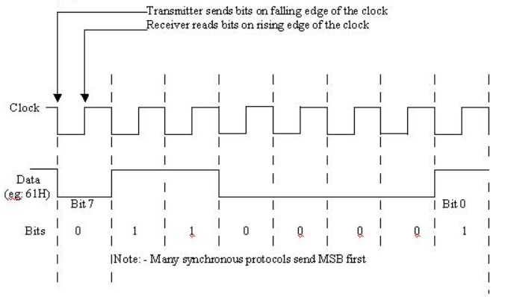
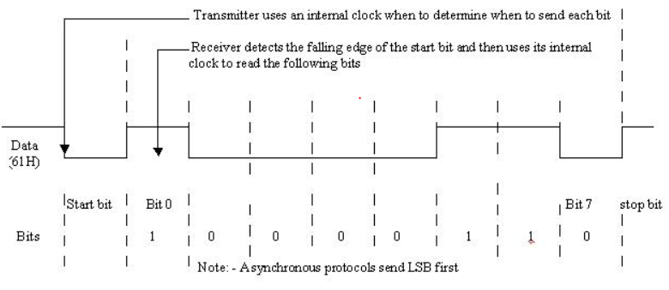
Electronics: Serial – Signaling
Synchronous
Has a Reference Clock
Additional expense!
Asynchronous
No Clock signal
Extra START/STOP markers!
Data rate vs Baud rate
Pay-load

Slide 9
Serial bus – uart (RS-232)

Slide 10
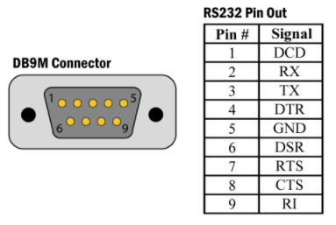
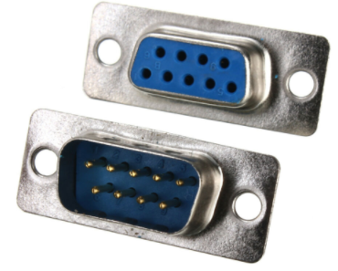
UART: The RS-232 standard
UART: Universal Asynchronous Receiver Transmitter
RS-232: Recommended Standard #232
Defined in 1960 as a serial communication standard
Intended for signaling between DTE (PC) and DCE (modem)
Original standard defined 25 signals, but only 3 are used today
RX (Receive), TX (Transmit), GND (Ground)
Connectors:
Old: DB-25, New: DB-9, Current: None (Use a USB-Serial adapter!)
Female
Male

Slide 11
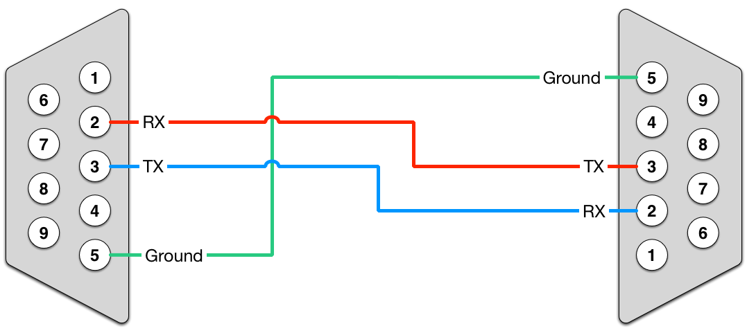
RS-232: Bus wiring
Device 1’s RX will go into Device 2’s TX
And vice-versa
Common ground

Slide 12
RS-232: Bus voltages, MCU interfacing
RS-232 voltage levels TTL voltage levels
+25V
Logic 0
5V
Logic 1
+3V
2V
0.8V
Logic 0
0V
-3V
Logic 1
Level shifting
(MAX232)
-25V

Slide 13
RS-232: Bus Nomenclature
Terminology
Examples
Baud Rate
Speed at which data travels
Most common: 9600 baud
Payload size
Size of ‘data payload’
Most common: 8-bit
Parity
Extra bits added for reducing effects of noise
Odd (O), Even (E) or None (N)
Stop bits
Extra bits to serve as stop markers
Note: Start marker is always 1-bit
9600/8-N-1
57600/8-E-1
115200/8-O-2
10-bit packet
11-bit packet
12-bit packet

Slide 14
RS-232: Limitations
Old standard
Pre-dates most computer technologies
Large connectors
Out of place with today’s equipment
Low noise immunity
Due to single-ended signaling
Low transmission speed
Less throughput
Short maximum cable length
~15m (subject to noise conditions and line capacitance)
Large voltages and voltage swings
TTL-incompatible, needs drivers
No multi-point capability
Point-to-point (P2P) bus
Limited multi-drop capability
Non-standard, unstable

Slide 15
Uart/rs-232 on pic18f

Slide 16

PIC18F: UART/RS-232
UART is realized through dedicated hardware module
UART resources
Registers
Pins
TX/RC6, RX/RC7
IF flags and IE flags
TXIF, RCIF (part of PIR1)
TXIE, RCIE (part of PIE1)
TXSTA | Transmit status and control
RCSTA | Receive status and control
TXREG | Transmit register
RCREG | Receive register
SPBRGH:SPBRG | Baud rate (speed) control

Slide 17
PIC18F: UART – TXSTA
CSRC
TX9
TXEN
SYNC
SENDB
BRGH
TRMT
TX9D
CSRC: Clock source select bit (Don’t care in Async mode)
TX9: 9-bit transmit enable bit
TXEN: Transmit mode enable bit
SYNC: Mode select bit
0: Async, 1: Sync
SENDB: Send break character bit
BRGH: High baud rate select bit
0: Low speed, 1: High speed
TRMT: Transmit shift register status bit
0: Full, 1: Empty
TX9D: 9th bit in 9-bit transmit mode
Value for Async mode Transmit: 0x20

Slide 18
PIC18F: UART – RCSTA
SPEN
RX9
SREN
CREN
ADDEN
FERR
OERR
RX9D
SPEN: Serial port enable bit
RX9: 9-bit receive enable bit
SREN: Single receive enable bit
Aysnc mode: Don’t care
CREN: Continuous receive enable bit
ADDEN: Address detect enable bit (9-bit)
FERR: Framing error bit
0: No framing error, 1: Framing error occurred
OERR: Overrun error bit
0: No overrun error, 1: Overrun error occurred
RX9D: 9th bit of 9-bit receive mode
Value for Async mode Receive: 0x90

Slide 19
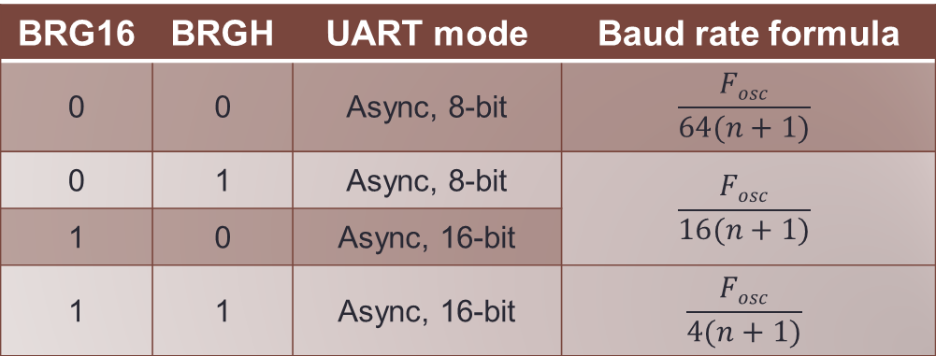

PIC18F: UART – Baud rate formulas
Baud rate of the UART port is determined by:
Values of
BRGH (TXSTA, bit 2) and BRG16 (BAUDCON, bit 3)
Contents of
SPBRGH:SPBRG registers (say, $n$)
BRG16 | BRGH | UART mode | Baud rate formula
0 | 0 | Async, 8-bit | $$\frac{Fosc}{64(n+1)}$$
0 | 1 | Async, 8-bit | $$\frac{Fosc}{16(n+1)}$$
1 | 0 | Async, 16-bit
1 | 1 | Async, 16-bit | $$\frac{Fosc}{4(n+1)}$$

Slide 20
PIC18F: UART – Transmit mode
Steps
Schematic
Enable transmit
Load TXSTA (0x20)
Determine speed
Load SPBRG’s, BRG16
Fix TX pin direction
Make TX/RC6 output
Clear IF flag
TXIF bit of PIR1
Enable serial port
SPEN bit of RCSTA
Load TXREG with data
Check for transmit complete
PIC18F4520
TXSTA
TXIF
RCSTA
FREG
TXREG
TSR
TX/RC6

Slide 21
PIC18F: UART – Receive mode
Steps
Schematic
Enable serial port, and continuous receive
Load RCSTA (0x90)
Determine speed
Load SPBRG’s, BRG16
Fix RX pin direction
Make RX/RC7 input
Clear IF flag
RCIF bit of PIR1
Wait for data reception
Monitor RCIF REG with data
Data available in RCREG!
PIC18F4520
RCSTA
RCIF
FREG
RCREG
RSR
RX/RC7

Slide 22
PIC18F: UART – Experiment topology
PIC dev board connected to PC’s serial port (COMx)
PC running serial port software: PuTTY / Hyper-terminal
PIC code should enable
UART Receive (data from PC)
UART Transmit (echo back data so received)
ABC…
PIC18F4520
UART code
RCREG
RX
TXREG
TX
Serial cable

Slide 23
Serial bus – i²c

Slide 24
I²C: The Standard
I²C: Inter Integrated Circuit
Defined by Philips (now NXP) in 1982 as a serial bus
Synchronous, Multi-master, Multi-slave
Multi-drop, Packet-switched, Half-duplex
Single-ended: 2 pins with 2 signals
SCL (System Clock), and SDA (System Data)
I²C: Wiring
No standards defined
Bus length limited by bus capacitance (<400pF)
Open-Collector / Open-Drain pins
I²C: Voltages
TTL compatible
Logic 1: 5V, 3.3V
Logic 0: 0V

Slide 25
I²C: Use-cases, speeds
Intended use
Popular bus for connecting peripheral devices to controllers / CPUs
Interacting with compatible EEPROMs, RTCs, NVRAM chips, …
Controlling low-speed ADCs, DACs
Controlling display properties (contrast, hue, colour balance) via DDC
Controlling low-end OLED / LCD displays
Interfacing with compatible sensors
System Management (via SMBus avatar)
Speeds
Standard (100 kbits/s)
Fast-mode (400 kbits/s)
High-speed (3.4 Mbits/s)
Ultra Fast-mode (5 Mbits/s)

Slide 26
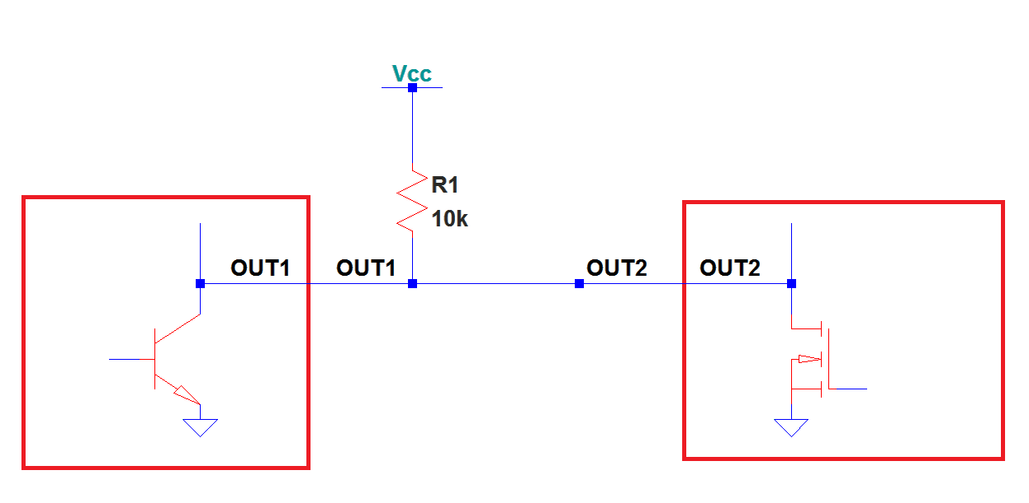
Electronics: Open collector / drain
Outputs left ‘floating’ (open)
Pull-up resistor used to ‘pull up’ the line to V_{cc}
When outputs are different: OUT1=1 and OUT2=0
Device sending 0 ‘wins’ over device sending 1
Open collector
Open drain
OUT1=1
Result=0
OUT2=0
Device 1
Device 2

Slide 27
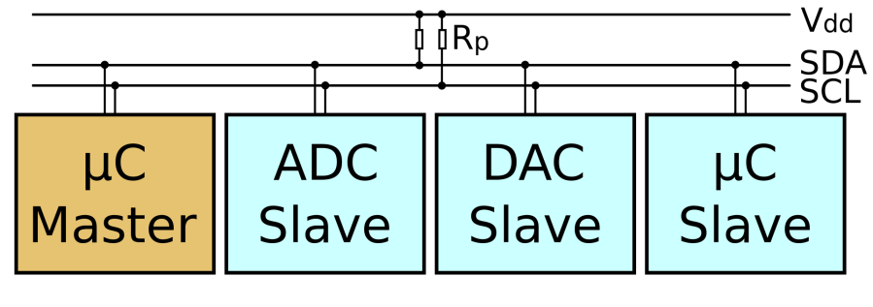
I²C: Open-collector / Open-drain
I²C Bus Topology
SCL and SDA lines are open-collector design
Pulled up to V_{CC} / V_{DD} (Logic 1)
Nothing to be done to send a Logic 1
Pulled down to ground (0V) to send a Logic 0
Device sending 0 ‘wins’ over device sending 1

Slide 28
I²C: Roles, Addressing
I²C Roles: 2 distinct roles defined
Master
Initiates communication (called ‘transactions’)
Drives the system clock (SCL)
Performs bus arbitration
Slave
Responds to master
Accepts data from master
Send data when asked by master
I²C Addressing:
Slaves need to have ‘addresses’ to exist on the bus
8-bit (actually 7+1) / 10-bit
Masters do not have addresses

Slide 29
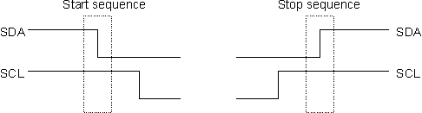
I²C: Signaling
I²C has special signals / sequences
To signify start and end of transactions
Combination of line (SCL, SDA) voltage conditions and waveforms
START sequence (symbol: “S”)
SCL stays HIGH, SDA goes from HIGH to LOW
STOP sequence (symbol: “P”)
SCL stays HIGH, SDA goes from LOW to HIGH

Slide 30
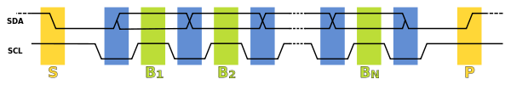

I²C: SCL, SDA relationship
Pin-wise:
SCL is Clock – Always driven by Master
SDA is Data – Driven by Master/Slave
SDA is stable when SCL is HIGH
Data is ‘sampled’ on the line by Master/Slave
SDA line is written MSB-first
8-bit packets
7-bit Slave address + 1 R/W bit
8-bit data
9th bit is driven LOW by other device as ACK

Slide 31
I²C: Bus modes, Transaction types
I²C bus modes
Master sending address/data to Slave
Master drives SCL and in charge of SDA
Slave sending data to Master
Master drives SCL, Slave in charge of SDA
I²C transaction types
I²C Write
Master writes data to Slave
I²C Read
Master reads data from Slave

Slide 32
I²C: Write Transaction – simple
Steps for an I²C Write (simple I²C Slave)
Start
Master sends START sequence
Slave identification by Slave address (W)
Master sends 7-bit Slave address (MSB-first)
Master send R/W bit (value 0 – meaning write)
Slave sends 1-bit ACK (value 0)
Data send-out
Master sends 8-bit data to Slave
Slave sends 1-bit ACK (value 0)
End
Master sends STOP sequence

Slide 33
I²C: Write Transaction – advanced
Steps for an I²C Write (memoried I²C Slave – EEPROM)
Start
Master sends START sequence
Slave identification by Slave address (W)
Master sends 7-bit Slave address (MSB-first)
Master send R/W bit (value 0 – meaning write)
Slave sends 1-bit ACK (value 0)
Slave internal location address send-out
Master sends 8-bit address of location inside Slave
Slave sends 1-bit ACK (value 0)
Data send-out
Master sends 8-bit data to Slave
Slave sends 1-bit ACK (value 0)
End
Master sends STOP sequence

Slide 34
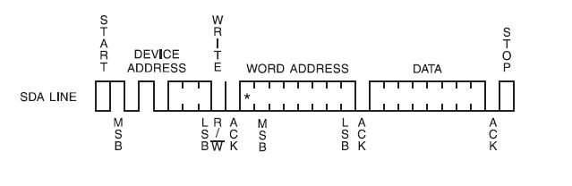
I²C: Advanced Write Illustration
Bus states for writing to I²C Slave – EEPROM
1
5
2
3
4

Slide 35
I²C: Read Transaction – advanced
Steps for an I²C Read (memoried I²C Slave – EEPROM)
Start
Master sends START sequence
Slave identification by Slave address (W)
Master sends 7-bit Slave address (MSB-first)
Master send R/W bit (value 0 – meaning write)
Slave sends 1-bit ACK (value 0)
Slave internal location address send-out
Master sends 8-bit address of location inside Slave
Salve sends 1-bit ACK (value 0)
Slave identification by Slave address (R)
Master sends 7-bit Slave address (MSB-first)
Master send R/W bit (value 1 – meaning read)
Slave sends 1-bit ACK (value 0)
Slave data send-out
Slave sends 8-bit data
Master sends 1-bit NACK (value 1)
Stop
Dummy Write

Slide 36
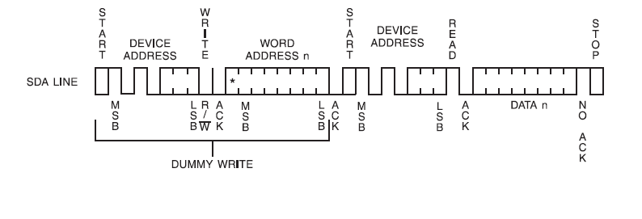
I²C: Advanced Read Illustration
Bus states for reading from I²C Slave – EEPROM
Repeated START
1
6
2
3
4
5

Slide 37
I²C: Clock Stretching
I²C devices
Masters are usually high-speed controllers
Slaves are usually low-speed devices
What if Slave can not keep up with Master?
Mechanism to let Slave ‘slow down’ the bus
Slave pulls the SCL line low
Master keeps a tab on the SCL line
‘Hold’ if it sees the SCL line held low
Resume only when SCL returns to normal
Since this ‘stretches’ the clock, it is called Clock Stretching
Uses the Open collector / drain property
Device sending Logic 0 ‘wins’ over device sending Logic 1

Slide 38
I²C: Bus Arbitration
Multi-master bus raises the question of Bus Arbitration
What if 2 Masters start transacting at the same time?
Again, use is made of the Open collector / drain property
Master sending 0 ‘wins’ over the Master sending 1
Master keeps a tab on SDA
Compares what it sends to what it senses
If it sent a 0 and got SDA LOW
Everything is alright
If it sent a 1 and got SDA HIGH
Everything is alright
If it sent a 1 and got SDA LOW
Some other Master is driving the bus!
This Master ‘loses’ Bus Arbitration and backs off
Will restart the transaction once it senses a STOP
Smooth back-off ensuring no transactional data is ‘lost’

Slide 39
I²C: Pluses and minuses
Pros
More advanced compared to UART
Multi-master, multi-slave, multi-drop
Scalable bus due to open collector/drain logic
Fans up to a dozen devices or so
TTL compatible signalling
Reduces system cost (no level shifting!)
Natural bus arbitration scheme reduces system complexity
Adjustable speed (flow control) through clock stretching
Enables low-end Slave participation
Cons
Complicated protocol with role-based transactions
Low throughput due to:
Overheads [START/STOP sequences, ACKs, address packets]
Half-duplex operation
Low speeds (kHz to 10’s of MHz)
Lesser bus length compared to UART (< 5m, within board/PCBA)
Could be remedied by I²C repeaters
Low bus membership due to 7-bit addressing
Pull-up resistors for SCL, SDA increase power dissipation
Faulty / rogue device can hang the bus!

Slide 40
i²c on pic18f

Slide 41
PIC18F: I²C Resources
Hardware module (shared with SPI)
MSSP – Master Synchronous Serial Port
MSSP Registers
Pins
SCL/RC3, SDA/RC4
Flags
SSPIF (part of PIR1)
SSPCON1, SSPCON2 | I²C bus control
SSPSTAT | I²C bus status
SSPADD | I²C bus speed
SSPBUF | I²C data register

Slide 42
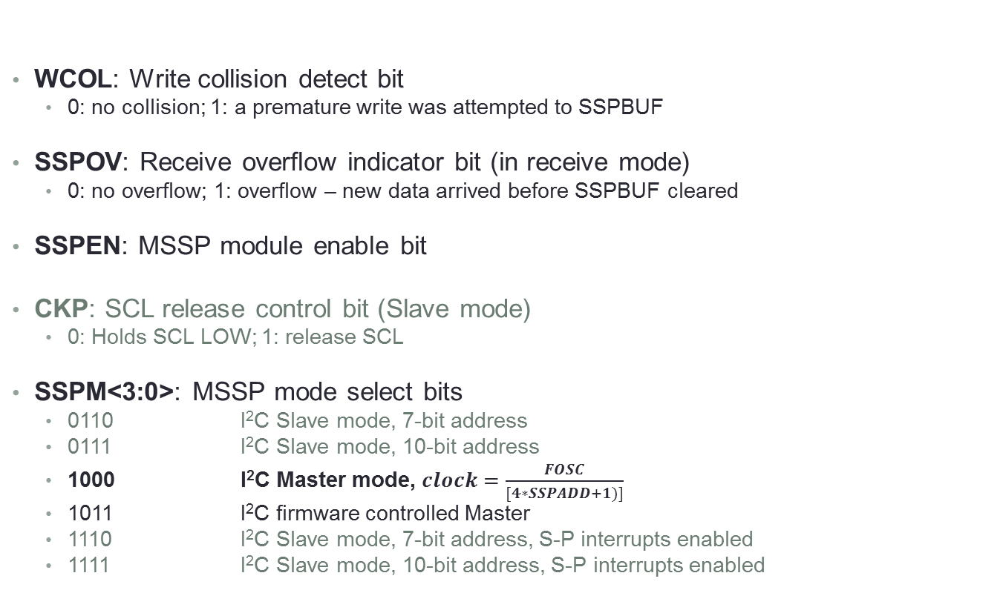
PIC18F: I²C – SSPCON1
WCOL
SSPOV
SSPEN
CKP
SSPM3
SSPM2
SSPM1
SSPM0
WCOL: Write collision detect bit
0: no collision; 1: a premature write was attempted to SSPBUF
SSPOV: Receive overflow indicator bit (in receive mode)
0: no overflow; 1: overflow – new data arrived before SSPBUF cleared
SSPEN: MSSP module enable bit
CKP: SCL release control bit (Slave mode)
0: Holds SCL LOW; 1: release SCL
SSPM<3:0>: MSSP mode select bits
0110 I²C Slave mode, 7-bit address
0111 I²C Slave mode, 10-bit address
1000 I²C Master mode, $clock=\frac{FOSC}{[4∗SSPADD+1)]}$
1011 I²C firmware controlled Master
1110 I²C Slave mode, 7-bit address, S-P interrupts enabled
1111 I²C Slave mode, 10-bit address, S-P interrupts enabled

Slide 43
PIC18F: I²C – SSPCON2
GCEN
ACKSTAT
ACKDT
ACKEN
RCEN
PEN
RSEN
SEN
GCEN: General call enable bit (Slave mode)
ACKSTAT: Acknowledge status bit (Master mode)
0: ACK wasn’t received from Slave; 1: ACK was received
ACKDT: Acknowledge data bit (Master receive mode)
0: ACK; 1: NACK
ACKEN*: Acknowledge enable (Master receive mode)
0: Disabled; 1: Enabled (sends ACKDT to Slave)
RCEN: Receive enable bit (Master mode)
PEN*: STOP sequence enable bit (Master mode only)
RSEN*: Repeated START enable bit (Master mode only)
SEN*:
Master mode: START sequence enable bit
Slave mode: Clock Stretch enable bit
* Automatically cleared by hardware
Master side (N)ACK

Slide 44
PIC18F: I²C – SSPSTAT
SMP
CKE
D/A
P
S
R/W
UA
BF
SMP: Slew rate control bit
0: Slew rate control enabled for high speed (400 kHz)
1: Slew rate control disabled for standard speed (100 kHz, 1MHz)
CKE: SMBus select bit (SMBus mode)
D/A: Data / address indicator (in Slave mode)
P: STOP sequence detected (cleared on a reset)
S: START sequence detected (cleared on a reset)
R/W: In Master mode, 1 means transmit in progress
UA: Update address (10-bit address mode)
BF: Buffer full indicator bit
0: empty, 1: full

Slide 45
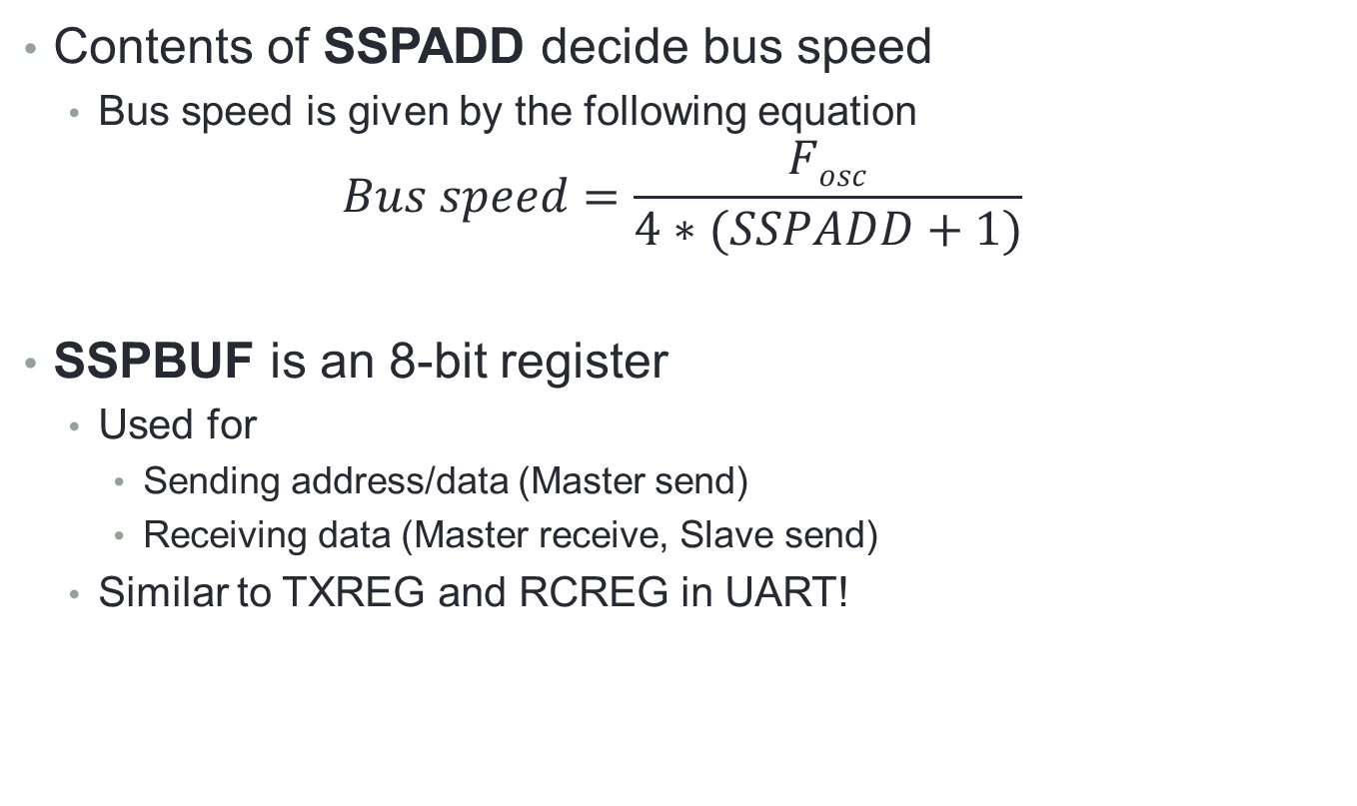
PIC18F: I²C – Bus speed, SSPBUF
Contents of SSPADD decide bus speed
Bus speed is given by the following equation
$$Bus speed=\frac{Fosc}{4∗(SSPADD+1)}$$
SSPBUF is an 8-bit register
Used for
Sending address/data (Master send)
Receiving data (Master receive, Slave send)
Similar to TXREG and RCREG in UART!

Slide 46
PIC18F: I²C – Code snippets
I²C initialization sequence
START, STOP, SEND functions
; 20MHz crystal, 100kHz
SPD_VAL EQU 0x49
BSF SSPSTAT, 7 ; sampling
BCF SSPSTAT, 6 ; slew rate disabled
MOVLW SPEED_VAL
MOVWF SSPADD ; loading SSPADD
; Master mode
BSF SSPCON1, SSPM3
BCF SSPCON1, SSPM2
BCF SSPCON1, SSPM1
BCF SSPCON1, SSPM0
BCF PIR1, SSPIF ; clear SSPIF
BSF SSPCON1, SSPEN ; enable MSSP module
I2CSTART
BSF SSPCON2, SEN
BTFSS PIR1, SSPIF
GOTO $-1
BCF PIR1, SSPIF
RETURN
I2CSTOP
BSF SSPCON2, PEN
BTFSS PIR1, SSPIF
GOTO $-1
BCF PIR1, SSPIF
RETURN
I2CSEND
MOVWF SSPBUF
BTFSS PIR1, SSPIF
GOTO $-1
BCF PIR1, SSPIF
RETURN

Slide 47
PIC18F: I²C – Code snippets - Write
Assumes data to be sent is in WREG
TMP EQU 0x20
I2CWRITE
MOVWF TMP ; save WREG contents away
CALL I2CSTART ; generate START sequence
MOVLW <SLAVE_ADDR> ; Slave address with WRITE enabled
CALL I2CSEND
MOVLW <SLAVE_LOCATION> ; address location inside Slave
CALL I2CSEND
MOVF TMP, W ; send data to Slave
CALL I2CSEND
CALL I2CSTOP ; generate STOP sequence
RETURN

Slide 48
PIC18F: I²C – Code snippets - Read
Data read in from Slave will be in WREG
I2CREAD
CALL I2CSTART ; generate START sequence
MOVLW <SLAVE_ADDR> ; Slave address with WRITE enabled
CALL I2CSEND
MOVLW <SLAVE_LOCATION> ; address location inside Slave
CALL I2CSEND
CALL I2CSTART ; repeated START
MOVLW <SLAVE_ADDR1> ; Slave address with READ enabled
CALL I2CSEND
BSF SSPCON2, RCEN ; enable Master receive mode
BTFSS PIR1, SSPIF ; wait for data reception (from Slave)
GOTO $-1
BCF PIR1, SSPIF
BSF SSPCON2, ACKEN ; enable Master ACK mode
BSF SSPCON2, ACKDT ; send a NACK from Master
MOVF SSPBUF, W
CALL I2CSTOP ; generate STOP sequence
RETURN

Slide 49
Serial bus – spi

Slide 50
SPI – The Standard
SPI: Serial Peripheral Interface
Defined by Motorola in the early 1980s, now a de facto standard
Synchronous, Single-master, Multi-slave
Multi-drop, Full-duplex, High-speed bus
4-wire / 4-pin signalling
SCLK (Serial Clock), SS (Slave Select) – active low
MOSI (Master Out Slave In), MISO (Master In Slave Out)
SPI wiring, voltages
No standards defined, TTL compatible
High speed restricts bus lengths (intra-board)

Slide 51
SPI: Use-cases, speeds
Intended use
Popular bus for connecting peripheral devices to controllers / CPUs
Sensors (temperature, pressure), ADCs, touchscreens
Control devices – audio codecs, digital pots, DACs
Camera lens and mount assemblies
Communications – ethernet, USB, CAN, IEEE 802.15.4, IEEE 802.11
Memories – flash, EEPROM (specially for boot-up)
Memory cards – MMC, SD Card
RTCs
LCDs (control - and sometimes, data)
Speeds
Absence of defined protocols and packet structure
Enables very high bus speeds (kHz to 100’s of MHz)

Slide 52
SPI: Device Roles
SPI Roles: 2 distinct roles defined
Master
Initiates communication (called ‘data frame’)
Drives the system clock (SCLK)
Selects a Slave by using the per-Slave active LOW SS line
Slave
Responds to master if it’s SS line is active
Full-duplex
Can receive from, as well as send to Master
Single Master, multiple Slaves bus
No defined packet / frame protocol
Designer free to select appropriate sized frames

Slide 53
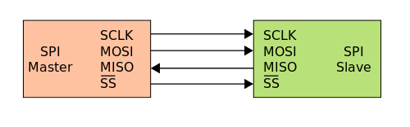
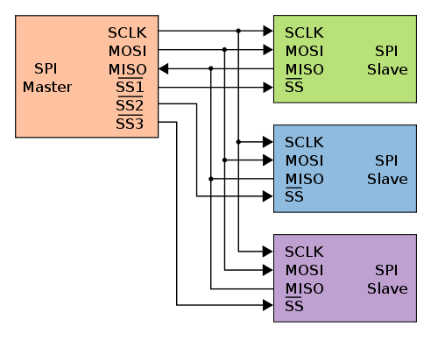
SPI: Bus topologies
Single Master, Single Slave
Master drives SCLK
Selects Slave by SS line
Optional since only 1 Slave
Hard-wire SS to 0!
Half or Full duplex operation
Single Master, Multiple Slaves
Master drives SCLK
Selects Slave by SS line
1 SS line per Slave!
Slaves share SCLK, MISO, MOSI lines
Non-participating Slaves need to tri-state these lines!
Half or Full duplex operation

Slide 54
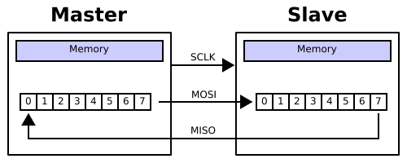
SPI: Bus operation
Master selects the Slave by de-asserting its SS line
For ‘slow’ devices, Master waits for a hold time
Master activates the clock on SCLK line
Full-duplex data transfer occurs
Master sends out a bit on MOSI, Slave receives it
Slave sends out a bit on MISO, Master receives it
Transmission occurs between n-bit registers in Master and Slave
Connected in a ‘virtual ring’ topology
Slave always sends data – not all transfers may be of value!

Slide 55
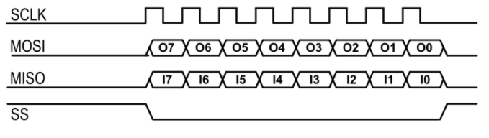
SPI – Line Waveform example
General line waveform
Master-Slave communication
Full-duplex, 8-bit communication
O<7:0> – Master to Slave
I<7:0> – Slave to Master

Slide 56
SPI: Pros and Cons
Pros
Very high throughput
High-speed, Full-duplex bus
Protocol flexibility
Arbitrary choice of word length (8/16/32/64…)
Simple hardware interfacing
No pull-up resistors
No arbitration messiness
No addressing complexities / restrictions
Cons
Rather costly
4-wire interface – high PCB real estate
1 SS line per Slave!
Restricted to a single master
No support for flow control by Slave
No error checks / parity included by default (has to be in software)
Difficult to add Slave devices
Usually needs a PCB respin!

Slide 57
Spi on pic18f

Slide 58
PIC18F: SPI Resources
Hardware module (shared with I²C)
MSSP – Master Synchronous Serial Port
MSSP Registers
Flags
SSPIF (part of PIR1)
SSPCON1 | SPI bus control
SSPSTAT | SPI bus status
SSPBUF | SPI data register

Slide 59
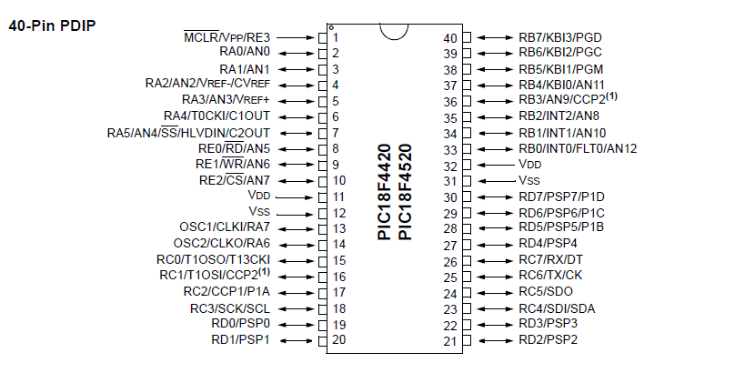
PIC18F: SPI Resources – Pins
SCLK = SCK/RC3, MOSI = SDI/RC4, MISO = SDO/RC5
SS = Any IO pin (Master mode), SS/RA5 (Slave mode)

Slide 60
PIC18F: SPI – SSPCON1
WCOL
SSPOV
SSPEN
CKP
SSPM3
SSPM2
SSPM1
SSPM0
WCOL: Write collision detect bit
0: no collision; 1: a premature write was attempted to SSPBUF
SSPOV: Receive overflow indicator bit (in Slave mode)
0: no overflow; 1: overflow – new data arrived before SSPBUF cleared
SSPEN: MSSP module enable bit
CKP: Clock polarity select bit
0: Idle is LOW; 1: Idle is high
SSPM<3:0>: MSSP mode select bits
0000 SPI Master mode, Clock = F_{osc}/4
0001 SPI Master mode, Clock = F_{osc}/16
0010 SPI Master mode, Clock = F_{osc}/64
0011 SPI Master mode, Clock = TMR2 output/2
0100 SPI Slave mode, Clock = SCK pin, SS pin control enabled
0101 SPI Slave mode, Clock = SCK pin, SS pin control disabled

Slide 61
PIC18F: SPI – SSPSTAT
SMP
CKE
D/A
P
S
R/W
UA
BF
SMP: Sample bit (Master mode, disabled [0] for Slave mode)
0: Input sampled at middle of data output time
1: Input sampled at end of data output time
CKE: SPI Clock select bit
0: Transmit on idle to active clock transition
1: Transmit on active to idle clock transition
D/A: Unused
P: Unused
S: Unused
R/W: Unused
UA: Unused
BF: Buffer full indicator bit (receive mode)
0: SSPBUF is empty, 1: receive complete, SSPBUF is full

Slide 62
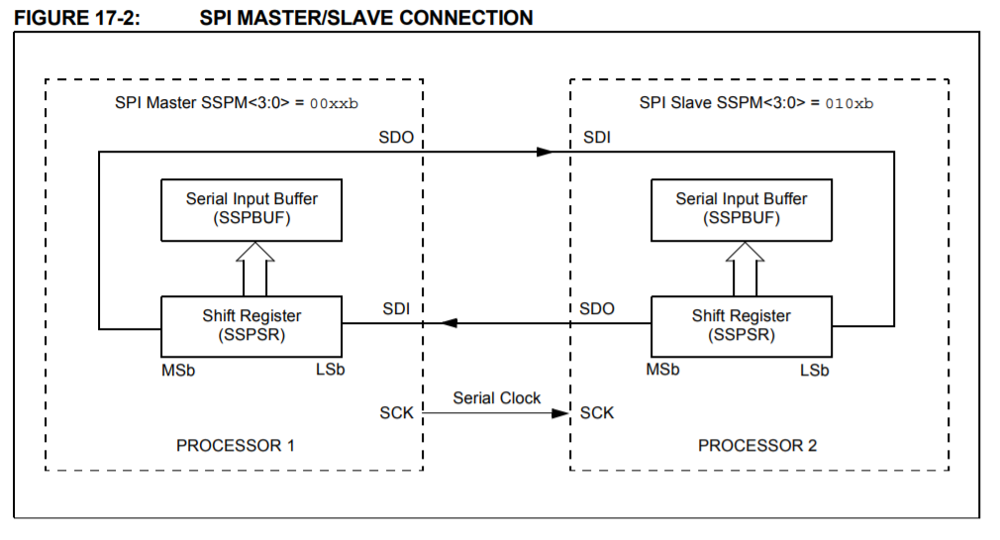
PIC18F: SPI – Master-Slave connects
2 PIC18Fs – one Master, another Slave
Internal ‘virtual-ring’ between Master-Slave

Slide 63
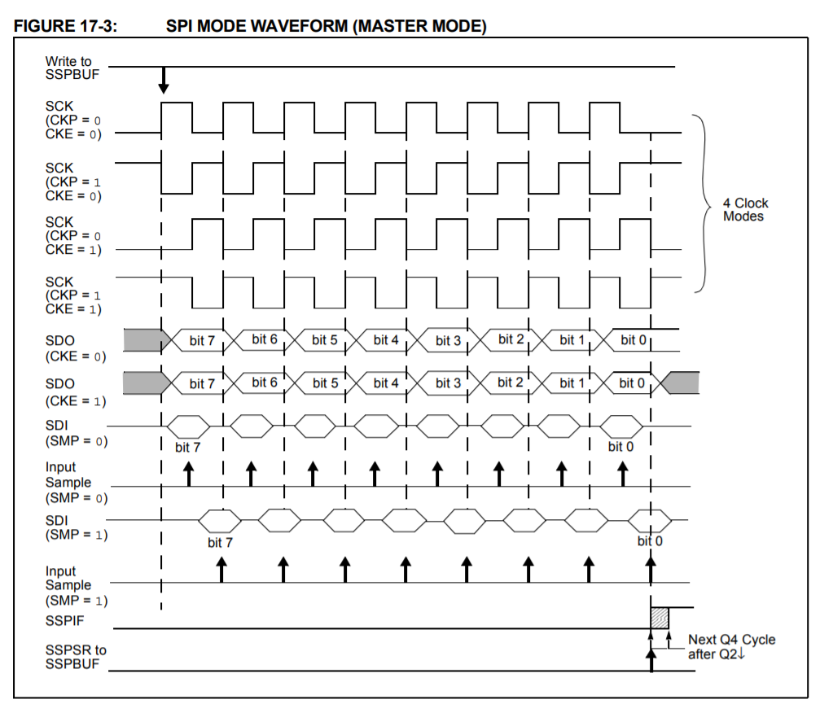
PIC18F: SPI – Clock Edge Signalling
SCLK, CKE, CKP and SMP relationships

Slide 64
PIC18F: SPI code snippet – Master
PIC as SPI Master (Full duplex), assumes Slave connected via RC2
DAT EQU 0xAB
BCF TRISC, 3 ; SCLK output
BCF TRISC, 4 ; SDO output
BSF TRISC, 5 ; SDI input
CLRF SSPSTAT ; Idle to Active Clock, BF to zero
MOVLW 0x20
MOVWF SSPCON1 ; Enable MSSP, Master, Fosc/4, idle LOW
BCF TRISC, 2 ; Set Slave’s SS line low
MOVLW DAT
MOVWF SSPBUF ; data to Slave
BTFSS SSPSTAT, BF ; wait for BF to go high
GOTO $-1
BSF TRISC, 2 ; disable Slave’s SS line
MOVWF SSPBUF, W ; data from Slave

Slide 65
PIC18F: SPI code snippet – Slave
PIC as SPI Slave in Receive mode
BSF TRISC, 3 ; SCLK input
BCF TRISC, 4 ; SDO output
BSF TRISC, 5 ; SDI input
BSF TRISA, 5 ; SS for Slave mode
CLRF SSPSTAT ; Idle to Active Clock, BF to zero
MOVLW 0x24
MOVWF SSPCON1 ; Enable MSSP, Slave, SS enabled
BTFSS SSPSTAT, BF ; wait for BF to go high
GOTO $-1
MOVWF SSPBUF, W ; data from Master

Slide 66
PIC18F: Serial Interfaces Summary
Serial vs. Parallel
Concepts
Pros and Cons
Serial interfaces
Signaling
Serial buses
UART/RS-232, I²C, SPI
Bus standards
Physical layer
Wiring, Voltages, Topologies
Packet formats and protocols
Merits and demerits, comparisons
PIC18F implementations and usage models
UART/RS-232 hardware module
MSSP

Slide 67
Thank you!

